Slide 1









My Algebra - Quadratics Interactive Notebook
$$×$$
$$\frac{1}{2}$$
$$÷$$
$$+$$
$$−$$
$$\frac{3}{5}$$
$$7$$
Name
Class
Teacher
Term 2 Semester 1
$$5^{2}$$
$$\sqrt{9}$$

Slide 2
Contents
Glossary or Formula Page
Page
Date
Description
2

Slide 3
Tasks
24
7
30
Essential Question
Questions
Notes
Summary
6

Slide 4
24
7
30
Date
Distributive Law and Factorisation
EQ – How do I Multiply or Factorise Across Brackets?

Slide 5



24
7
30
Date
Expanding Brackets
EQ – How do I use the distributive law to expand expressions with brackets?
What is the distributive law?
$$a\left(b+c\right)=a×b+a×c$$
How do I expand Brackets?
Expand $2\left(x+1\right)=2x+2$
$×$ | $$x$$ | +1
2 | $$2x$$ | +2
or $2\left(x+1\right)=2×x+2×1=2x+2$
Expand $3p\left(5p−7\right)=15p^{2}−21p$

Slide 6
24
7
30
Date
Expanding Brackets
EQ – How do I use the distributive law to expand expressions with brackets?
What is the distributive law?
$$a\left(b+c\right)=a×b+a×c$$
How do I expand Brackets?
Expand $2\left(x+1\right)=2x+2$
$×$ | $$x$$ | +1
2 | $$2x$$ | +2
or $2\left(x+1\right)=2×x+2×1=2x+2$
Expand $3p\left(5p−7\right)=15p^{2}−21p$

Slide 7
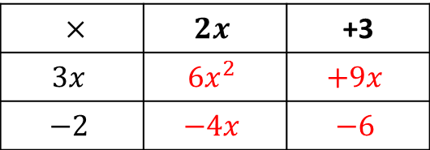

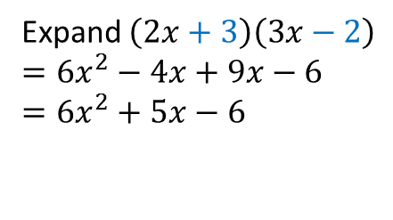
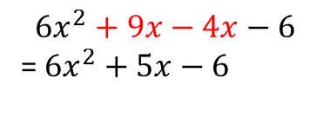
24
7
30
Date
Expanding Binomial Expressions
EQ – How do I expand two brackets?
How do I use the table method?
Expand $(2x+3)(3x−2)$
$×$ | $$2x$$ | +3
$$3x$$ | $$6x^{2}$$ | $$+9x$$
$$−2$$ | $$−4x$$ | $$−6$$
$$6x^{2}+9x−4x−6$$
=$6x^{2}+5x−6$
How do I use the FOIL method?
First
Outside
Inner
Last
Expand $\left(2x+3\right)\left(3x−2\right)$
$$=6x^{2}−4x+9x−6$$
$$=6x^{2}+5x−6$$

Slide 8

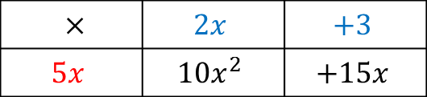
24
7
30
Date
Factorising Expressions
EQ – How do I use the HCF to factorise expressions?
What is the HCF?
HCF – Highest Common factor
How do I factorise?
Factorise $2p+10$
Divide terms by HCF
$×$ | $$p$$ | +5
2 | $$2p$$ | +10
Find the HCF of both terms
Write the expression using brackets
$$2(p+5)$$
Factorise $10x^{2}+15x$
$×$ | $$2x$$ | $$+3$$
$$5x$$ | $$10x^{2}$$ | $$+15x$$
$$10x^{2}+15x=5x(2x+3)$$

Slide 9
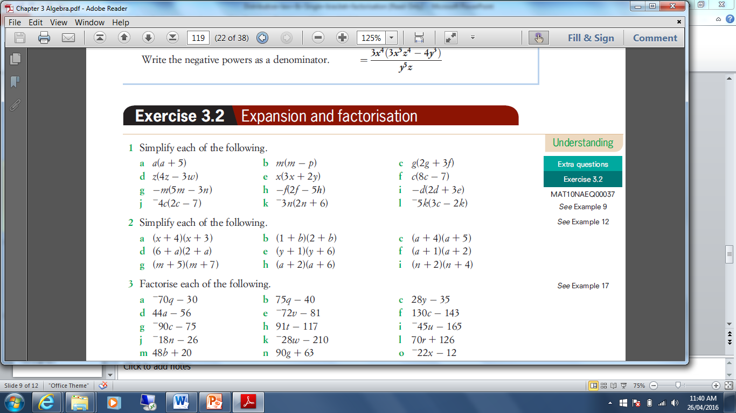
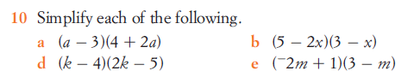
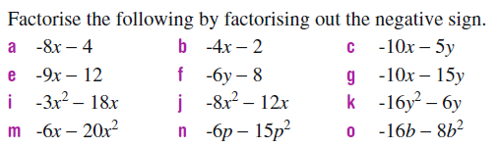

Slide 10
Exercises
Exercise 6.1 and 6.2 from Dwyer
All to be done with a smile on your faces.

Slide 11
Notes Review
24, 7 ,30
Date
Title
Essential question
Notes complete
Notes complete with colour and diagrams
Questions completed
Contents page filed in
Formula page filled in

Slide 12
Homework
Review your notes and write a summary answering the essential question.

